Slide 1






Green University of Bangladesh
Department Of Computer Science and Engineering(CSE)
Course Title: Web Programming
Course Code: CSE 301 Section: 213 D3
Presented to
Firoza Naznin
Lecturer, Dept. of CSE
Green University Of Bangladesh

Slide 2

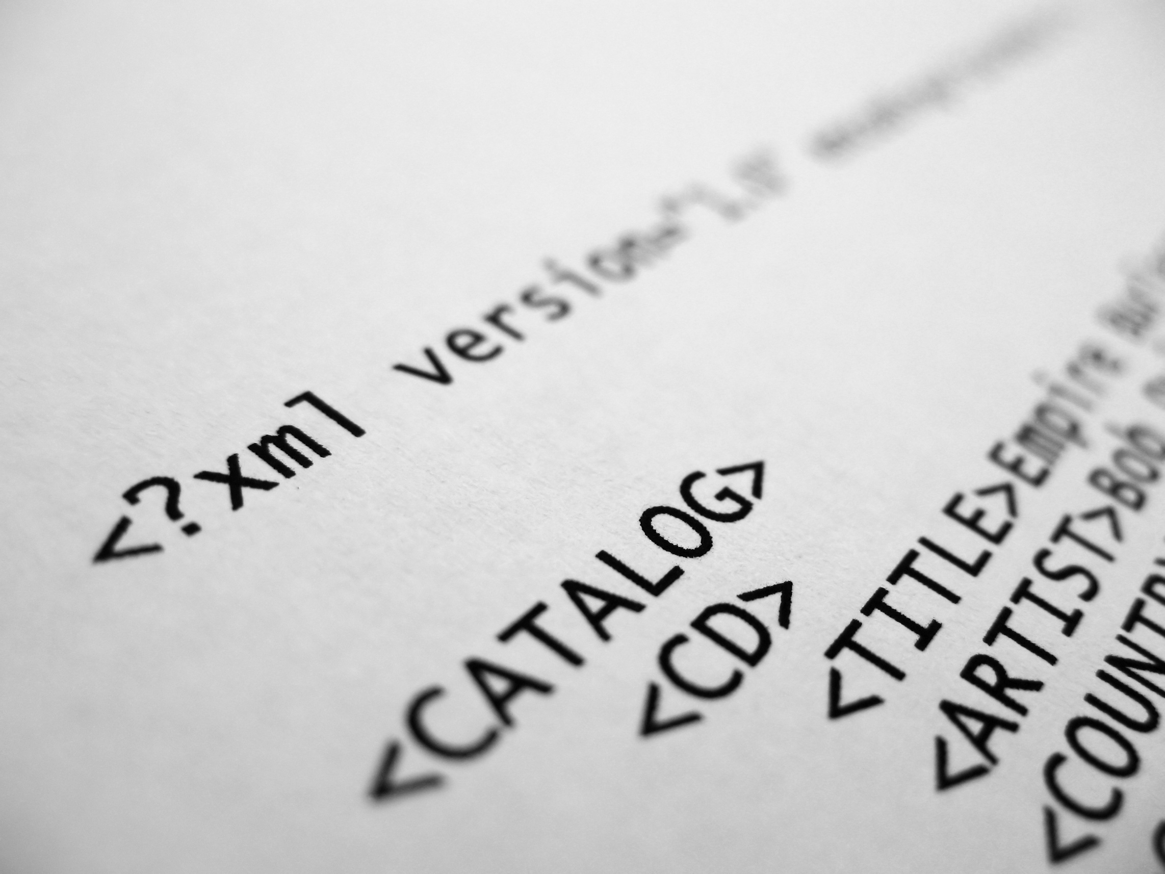






XML
Welcome To Our Presentation

Slide 3





Md. Zahidul Islam
221902091
Meet
The Team
Md. Mahim Hossain
221902082
Farhan Billah
221902271

Slide 4


TABLE OF CONTENTS
Introduction
Basic XML Syntax
XML Data Model
Comparison between XML and HTML
XML Building Blocks
Advantages and Disadvantages
Application of XML
Challenges
Summary
Conclusion

Slide 5



INTRODUCTION
XML - eXtensible Markup Language

Slide 6


BASIC XML SYNTAX
<?xml version="1.0" encoding="UTF-8"?>
<bookstore>
<book category="cooking">
<title lang="en">Everyday Italian</title>
<author>Giada De Laurentiis</author>
<year>2005</year>
<price>30.00</price>
</book>
</bookstore>

Slide 7

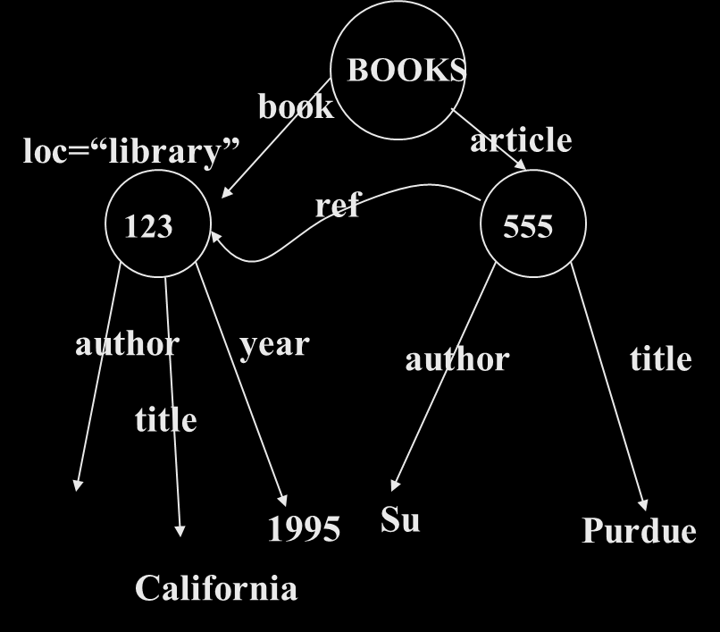
XML DATA MODEL
<BOOKS>
<book id=“123” loc=“library”>
<author>Hull</author>
<title>California</title>
<year> 1995 </year>
</book>
<article id=“555” ref=“123”>
<author>Su</author>
<title> Purdue</title>
</article>
</BOOKS>

Slide 8



COMPARISONS
XML
HTML
Extensible set of tags
Content orientated
Standard Data infrastructure
Allows multiple output forms
Fixed set of tags
Presentation oriented
No data validation capabilities
Single presentation
VS

Slide 9


XML BUILDING BLOCKS
Tags
Elements
Contents
Attributes
Comments

Slide 10


ADVANTAGES AND DISADVANTAGES
Advantages
Disadvantages
User-friendly interface
Drag-and-drop support
Real-time validation for XML syntax
Tree view for easy navigation
Limited to Windows-only
Basic feature set compared
to specialized XML editors
It may not support advanced XML schema validation
And

Slide 11


APPLICATION OF XML
Database application
Document Mark-up
Mathematical Mark-up
Metacontent definition

Slide 12


CHALLENGES
Complexity
Performance
Human Readability
Overhead
Schema Rigidity
Tooling and Support

Slide 13


SUMMARY
A versatile markup language
Used for data representation
Key topics covered:
Syntax and data model
Building blocks of XML
Comparison with HTML
Applications of XML
Challenges of using XML
Highlights:
Extensibility and platform independence
Important applications in web services and configuration files

Slide 14


CONCLUSION
XML's ongoing relevance in web programming and data interchange
Key strengths:
Extensive metadata support
Handling complex data structures
Importance of understanding appropriate use cases for XML
Encouragement to explore and master XML for enhanced web programming skills

Slide 15



Thanks for Watching
MAY 23, 2024

